Slide 1




GRADE 9-10 · AP PRECALCULUS · UNIT 1
Topic 1.11
Equivalent
Representations
Journey of 6 stations, 60 minutes
Polynomial and Rational Functions
Mr Malek Thiab
FAITH, RIGHTEOUSNESS AND WISDOM
Notes:
Speaker notes: Welcome to Topic 1.11: Equivalent Representations.
Timing: 60 minutes (Diagnose 6, Targeted Instruction 18, Practice 12, Production 12, Mastery Gate 6, Smart Production 6). For a 40-minute class scale every station by two thirds.
The journey map on the next slide shows the six stations; in slideshow mode the Morph transition zooms the station circles into the breadcrumb at the top of every later slide.

Slide 2


Today's journey
Six stations. Each one zooms in as we arrive.
Targeted Instruction
18 min
Production
12 min
Smart Production
6 min
2
4
6
1
3
5
Diagnose
6 min
Practice
12 min
Mastery Gate
6 min
FAITH, RIGHTEOUSNESS AND WISDOM
Notes:
Speaker notes: This is the whole map. Walk it left to right: Diagnose (what we already know), Targeted Instruction (Factored form and standard form; Polynomial long division; The binomial theorem), Practice (Practice, Apply, Investigate), Production (average cost at a workshop), Mastery Gate (three questions to pass), Smart Production (create, then Time to Check).
In slideshow mode the Morph transition animates these circles shrinking into the breadcrumb on later slides; without Morph the slides fade.
Ask the class which station they think will be hardest.

Slide 3
What we are learning
OBJECTIVES
VOCABULARY
Rewrite polynomial and rational expressions in equivalent forms.
Determine the quotient of two polynomial functions using long division.
Rewrite the repeated product of binomials using the binomial theorem.
factored form
standard form
equivalent forms
polynomial long division
quotient
remainder
slant asymptote
binomial theorem
Pascal's Triangle
STANDARDS
LO 1.11.A Rewrite polynomial and rational expressions in equivalent forms.
LO 1.11.B Determine the quotient of two polynomial functions using long division.
LO 1.11.C Rewrite the repeated product of binomials using the binomial theorem.
LO 1.11.A · LO 1.11.B · LO 1.11.C
FAITH, RIGHTEOUSNESS AND WISDOM
Mr Malek Thiab · 3
Notes:
Speaker notes: Read the objectives aloud one at a time and have students say which one they feel least sure about.
Vocabulary used today: factored form, standard form, equivalent forms, polynomial long division, quotient, remainder, slant asymptote, binomial theorem, Pascal's Triangle.
Standards are listed on this slide.
The essential question and mathematical practices are not shown because they are not in the project documents; add them from the curriculum map if you want them displayed.

Slide 4

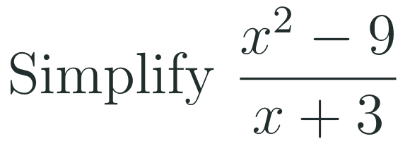
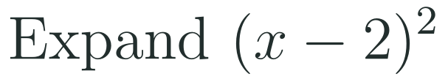
1
2
3
4
5
6
STATION 1 · DIAGNOSE · 6 MIN
Start here: three quick checks
1
2
3
Done when
All three answers are written without a calculator, and you can say how you checked each one by multiplying back.
LO 1.11.A · LO 1.11.B · LO 1.11.C
FAITH, RIGHTEOUSNESS AND WISDOM
Mr Malek Thiab · 4
Notes:
Speaker notes (Diagnose, 6 min, no calculator):
Speaker notes (Diagnose, 6 min, no calculator).
Solutions: Q1 x^2 - x - 12 = (x - 4)(x + 3), because -4 and 3 multiply to -12 and add to -1. Q2 (x - 3)(x + 3)/(x + 3) = x - 3 for x not equal to -3. Q3 (x - 2)^2 = x^2 - 4x + 4.
Verbal misconceptions: 'factor pairs only need the right product' (check the sum); 'cancel the x^2 and the 9'; '(x - 2)^2 = x^2 - 4' (the middle term is missing).
Adaptive routing: if more than 30% miss Q1 or Q2, route to slide 5 (factored form). If more than 30% miss Q3, route to slide 7 (binomial theorem).

Slide 5
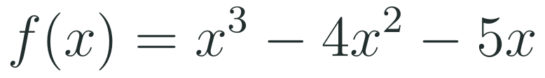
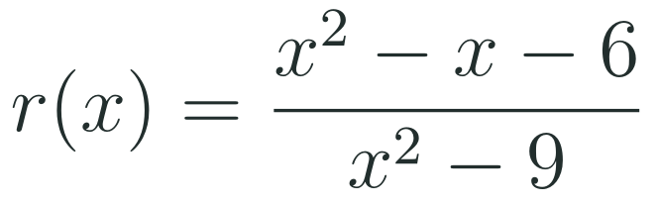
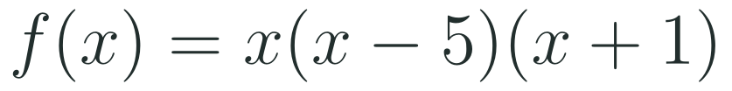
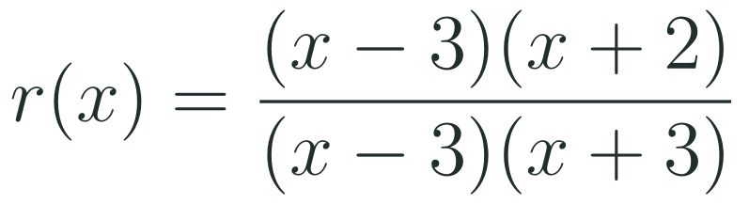

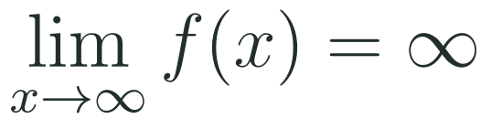
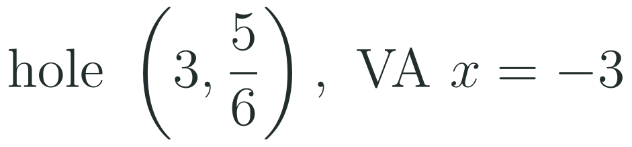

1
2
3
4
5
6
STATION 2 · TARGETED INSTRUCTION · 18 MIN
Factored form and standard form
EXAMPLE A
EXAMPLE B
LO 1.11.A · LO 1.11.B · LO 1.11.C
FAITH, RIGHTEOUSNESS AND WISDOM
Mr Malek Thiab · 5
Notes:
Speaker notes (Targeted Instruction, block 1 of 3):
Speaker notes (Targeted Instruction, block 1 of 3, LO 1.11.A). EK 1.11.A.1: 'Because the factored form of a polynomial or rational function readily provides information about real zeros, it can reveal information about x-intercepts, asymptotes, holes, domain, and range.' EK 1.11.A.2: 'The standard form of a polynomial or rational function can reveal information about end behaviors of the function.' EK 1.11.A.3: 'The information extracted from different analytic representations of the same polynomial or rational function can be used to answer questions in context.'
Worked solutions: Example A: x^3 - 4x^2 - 5x = x(x^2 - 4x - 5) = x(x - 5)(x + 1); zeros -1, 0, 5. The standard form has leading term x^3, so f tends to infinity as x tends to infinity. Example B: x^2 - x - 6 = (x - 3)(x + 2) and x^2 - 9 = (x - 3)(x + 3). The common factor x - 3 gives a hole at x = 3; the reduced function (x + 2)/(x + 3) has value 5/6 there, so the hole is (3, 5/6). The factor x + 3 stays in the denominator: vertical asymptote x = -3. The zero is x = -2. Equal degrees with ratio 1/1 give the horizontal asymptote y = 1.
Verbal misconceptions: 'a common factor that cancels leaves no trace' (it leaves a hole); 'a hole and a vertical asymptote are the same thing'.
Adaptive routing: if more than 30% miss Gate Q1, return to this slide and redo Example A aloud.

Slide 6


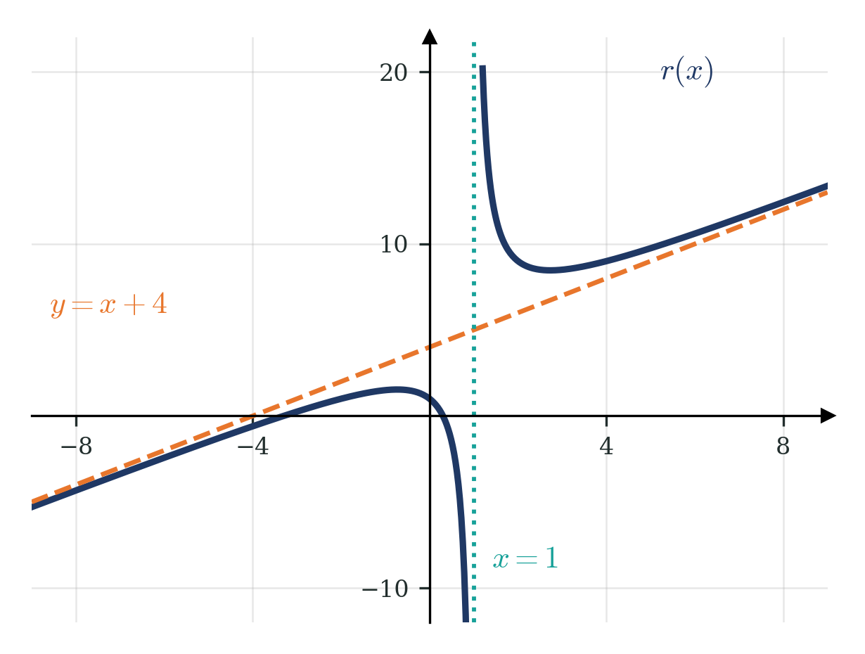
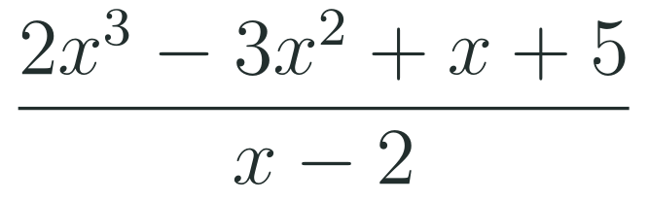
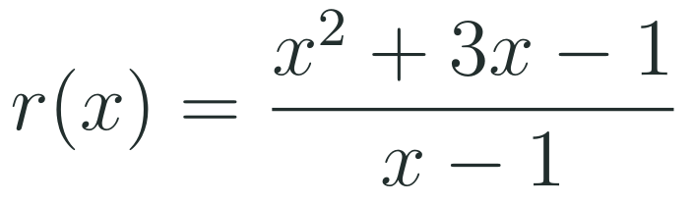
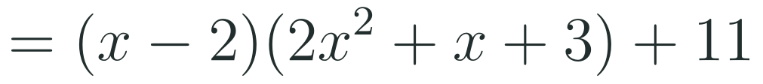
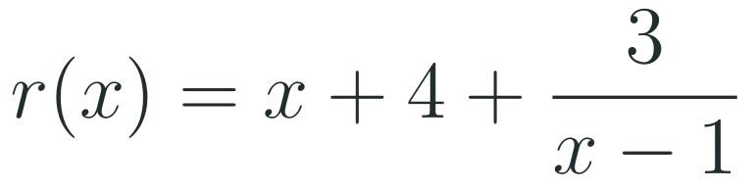
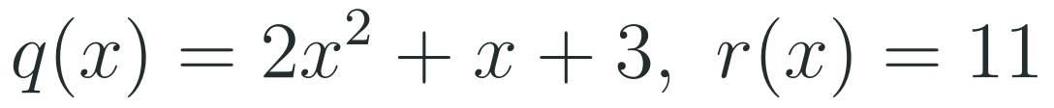
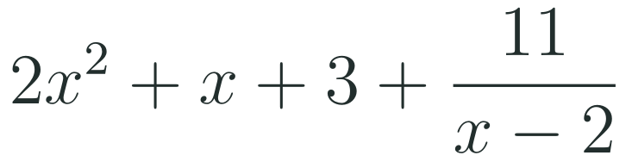

1
2
3
4
5
6
STATION 2 · TARGETED INSTRUCTION · 18 MIN
Polynomial long division
EXAMPLE A
EXAMPLE B
LO 1.11.A · LO 1.11.B · LO 1.11.C
FAITH, RIGHTEOUSNESS AND WISDOM
Mr Malek Thiab · 6
Notes:
Speaker notes (Targeted Instruction, block 2 of 3):
Speaker notes (Targeted Instruction, block 2 of 3, LO 1.11.B). EK 1.11.B.2: 'The result of polynomial long division is helpful in finding equations of slant asymptotes for graphs of rational functions.' EK 1.11.B.1 describes long division as an algebraic process similar to numerical long division with a quotient and a remainder; the fetched wording was partly garbled (check against the CED PDF).
Worked solutions: Example A: divide by x - 2 (synthetic division with 2): coefficients 2, -3, 1, 5 become 2, 1, 3, 11. So the quotient is 2x^2 + x + 3 and the remainder is 11; check: (x - 2)(2x^2 + x + 3) = 2x^3 - 3x^2 + x - 6 ... plus 11 gives 2x^3 - 3x^2 + x + 5. Example B: divide by x - 1 with 1: coefficients 1, 3, -1 become 1, 4, 3. So r(x) = x + 4 + 3/(x - 1). As x grows large the fraction tends to 0, so the graph approaches the line y = x + 4. The denominator is zero at x = 1: vertical asymptote.
Verbal misconceptions: 'the remainder goes in the quotient'; 'the degree of the remainder can equal the degree of the divisor'; 'a slant asymptote is the same as a horizontal asymptote'.
Adaptive routing: if more than 30% miss Gate Q2, return to this slide and redo Example A with the remainder written as a fraction.

Slide 7
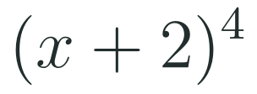
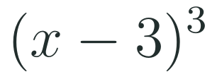
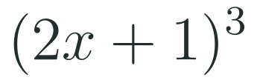


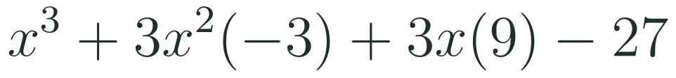
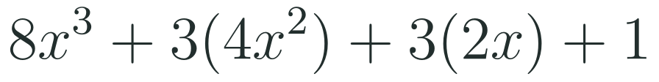


1
2
3
4
5
6
STATION 2 · TARGETED INSTRUCTION · 18 MIN
The binomial theorem
EXAMPLE A
EXAMPLE B
EXAMPLE C
LO 1.11.A · LO 1.11.B · LO 1.11.C
FAITH, RIGHTEOUSNESS AND WISDOM
Mr Malek Thiab · 7
Notes:
Speaker notes (Targeted Instruction, block 3 of 3):
Speaker notes (Targeted Instruction, block 3 of 3, LO 1.11.C). EK 1.11.C.1 (partly garbled in the fetched text; check against the CED PDF): the binomial theorem uses one row of Pascal's Triangle to expand (a + b)^n more easily, including polynomial functions of the form p(x) = (x + c)^n.
Worked solutions: Example A: row 4 is 1, 4, 6, 4, 1. Powers of 2 are 1, 2, 4, 8, 16, giving x^4 + 8x^3 + 24x^2 + 32x + 16. Example B: row 3 is 1, 3, 3, 1 with c = -3: powers of -3 are 1, -3, 9, -27, so x^3 - 9x^2 + 27x - 27. Example C: a = 2x, b = 1: 8x^3 + 3(4x^2) + 3(2x) + 1 = 8x^3 + 12x^2 + 6x + 1.
Verbal misconceptions: '(x + 2)^4 = x^4 + 16' (the middle terms are missing); 'the coefficient is only the Pascal number' (multiply by the power of c); 'with a negative c every sign is positive'; 'in (2x + 1)^3 the 2 is not cubed'.
Adaptive routing: if more than 30% miss Gate Q3, return to this slide; build Pascal rows 1 to 5 on the board first.

Slide 8
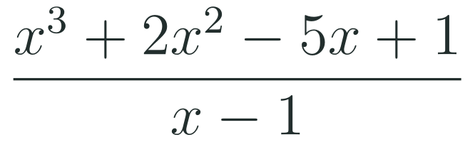

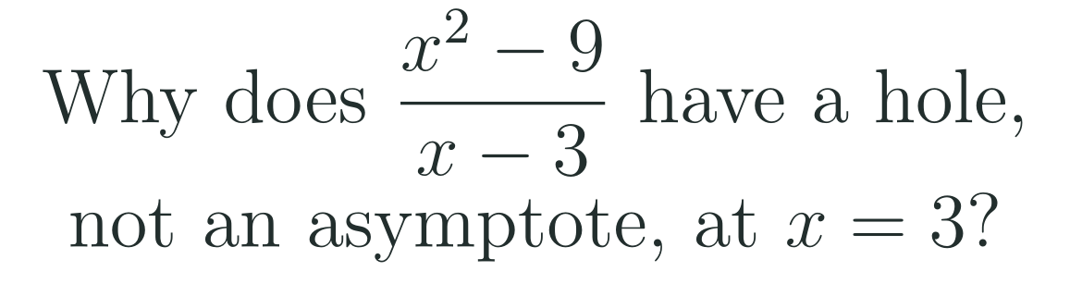
1
2
3
4
5
6
STATION 3 · PRACTICE · 12 MIN
Give it a go: Practice, Apply, Investigate
PRACTICE
APPLY
INVESTIGATE
Secure the method
Use it in context
Find out why
Done when: you write the result as quotient plus remainder over the divisor and name the quotient and the remainder.
Done when: the expansion uses a row of Pascal's Triangle and you check it with edge 3 cm (volume 27 cubic centimetres).
Done when: your explanation names the common factor and gives the coordinates of the hole.
LO 1.11.A · LO 1.11.B · LO 1.11.C
FAITH, RIGHTEOUSNESS AND WISDOM
Mr Malek Thiab · 8
Notes:
Speaker notes (Practice, 12 min; tierless differentiation: students choose the starting column and may move across):
Speaker notes (Practice, 12 min; tierless: students choose the starting column and may move across).
Answers: Practice: synthetic division with 1: coefficients 1, 2, -5, 1 become 1, 3, -2, -1, so the quotient is x^2 + 3x - 2 and the remainder is -1: x^2 + 3x - 2 - 1/(x - 1). Apply: (x + 2)^3 = x^3 + 6x^2 + 12x + 8; at x = 1 this is 27 = 3^3. Investigate: (x^2 - 9)/(x - 3) = (x + 3)(x - 3)/(x - 3); the factor x - 3 cancels, so the graph is the line y = x + 3 with a hole at (3, 6).
Verbal misconceptions: 'if the denominator is zero there is always an asymptote'.
Adaptive routing: finished students move to Apply then Investigate; stuck students return to slide 6.

Slide 9
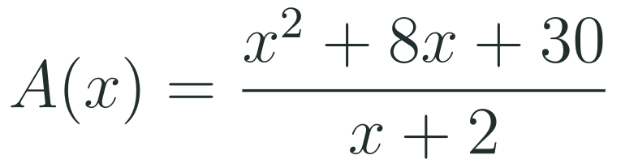

1
2
3
4
5
6
STATION 4 · PRODUCTION · 12 MIN
Production: average cost at a workshop
THE MODEL
DONE WHEN
A workshop makes custom phone cases. The model below gives the average cost in dollars per case when a given number of hundreds of cases is made. The numbers are model values for practice, not real costs.
The quotient and remainder are both named.
The slant asymptote is written as an equation.
The meaning is given in dollars per case.
Both values for 800 cases are equal and shown.
Use long division to write the average cost as quotient plus remainder over the divisor.
State the slant asymptote and say what it tells the workshop about large orders.
Check your rewritten form by finding the average cost for 800 cases both ways.
Hint: divide by x + 2, so use -2 in synthetic division.
LO 1.11.A · LO 1.11.B · LO 1.11.C
FAITH, RIGHTEOUSNESS AND WISDOM
Mr Malek Thiab · 9
Notes:
Speaker notes (Production, 12 min):
Speaker notes (Production, 12 min).
Solutions: Synthetic division with -2: coefficients 1, 8, 30 become 1, 6, 18. So A(x) = x + 6 + 18/(x + 2): quotient x + 6, remainder 18. Task 2: the slant asymptote is y = x + 6; for large orders the average cost per case is close to x + 6 dollars, so it keeps growing with x in this model. Task 3: original form (64 + 64 + 30)/10 = 15.8; rewritten form 8 + 6 + 18/10 = 15.8; both 15.80 dollars.
Verbal misconceptions: using +2 in synthetic division; writing the remainder as a number added to the quotient.
Adaptive routing: if students cannot start, send them to slide 6 Example A and the hint.

Slide 10

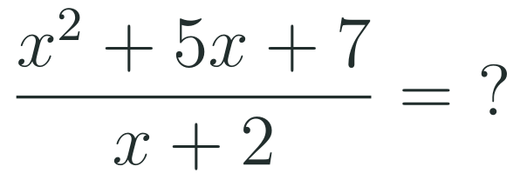
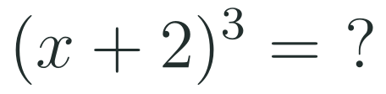
1
2
3
4
5
6
STATION 5 · MASTERY GATE · 6 MIN
Mastery Gate: three questions to pass
1
2
3
Pass mark
3 of 3 correct unlocks Station 6. Fewer than that: return to the slide for the question you missed, redo it, then re-take the gate.
LO 1.11.A · LO 1.11.B · LO 1.11.C
FAITH, RIGHTEOUSNESS AND WISDOM
Mr Malek Thiab · 10
Notes:
Speaker notes (Mastery Gate, 6 min, no calculator):
Speaker notes (Mastery Gate, 6 min, no calculator).
Answers: Q1 x^3 - 9x = x(x - 3)(x + 3), zeros -3, 0, 3. Q2 synthetic division with -2: 1, 5, 7 become 1, 3, 1, so x + 3 + 1/(x + 2). Q3 x^3 + 6x^2 + 12x + 8.
Verbal misconceptions: Q1 'divide by x and lose the zero at 0'; Q2 'remainder 1 written as +1 in the quotient'; Q3 'x^3 + 8'.
Adaptive routing: Q1 missed, route to slide 5 Example A; Q2 missed, route to slide 6 Example A; Q3 missed, route to slide 7.

Slide 11
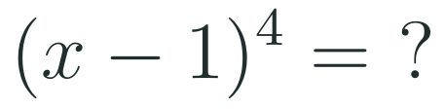
1
2
3
4
5
6
STATION 6 · SMART PRODUCTION · 6 MIN
Smart Production: make one, then check it
CREATE
TIME TO CHECK
Write a rational function in factored form with a hole where x is 2 and a vertical asymptote where x is negative 1.
Expand it to standard form on the back.
Swap with a partner: they find the hole, the asymptote and one zero.
Exit ticket: write your answer on a sticky note and place it on the door.
Done when: your partner confirms the hole, the asymptote and the zero from the factored form.
Next lesson: Topic 1.12 Transformations of Functions.
LO 1.11.A · LO 1.11.B · LO 1.11.C
FAITH, RIGHTEOUSNESS AND WISDOM
Mr Malek Thiab · 11
Notes:
Speaker notes (Smart Production, 6 min):
Speaker notes (Smart Production, 6 min).
Create example: (x - 2)(x + 3)/((x - 2)(x + 1)): hole where x = 2 (y = 5/3), asymptote x = -1, zero x = -3. Exit answer: row 4 with c = -1: x^4 - 4x^3 + 6x^2 - 4x + 1.
Verbal misconceptions: students keep all signs positive; ask: what happens to the sign of each term when c is negative?

Slide 12
Journey complete
Targeted Instruction
Production
Smart Production
✓
✓
✓
✓
✓
✓
Diagnose
Practice
Mastery Gate
Factored form shows zeros and holes, standard form shows end behavior, long division reveals the slant asymptote, and Pascal's Triangle expands repeated binomials.
FAITH, RIGHTEOUSNESS AND WISDOM
Notes:
Speaker notes: Every station is checked off. Recap in one sentence: Factored form shows zeros and holes, standard form shows end behavior, long division reveals the slant asymptote, and Pascal's Triangle expands repeated binomials. Collect the Time to Check responses. Next lesson: Topic 1.12 Transformations of Functions.

